Slide 1
Don’t Count Me Out:
Accounting for Multiracial Individuals in Segregation Studies
Paul A. Jargowsky
Rutgers University - Camden

Slide 2
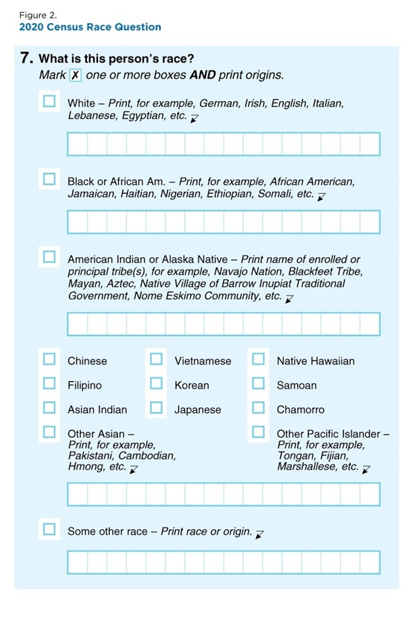
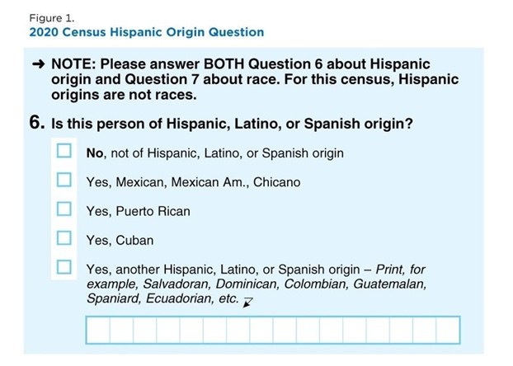
Changes in Census Racial Classifications
1990s social movement to recognize multiracial people
  Reclassify All Children Equally (RACE)
  Association of Multiethnic Individuals
Wanted a separate “multiracial” category
But that category combines many dissimilar types.
Instead, in 2000, instructions changed to “mark one or more boxes.”
However, the Hispanic ethnicity question was not changed.

Slide 3
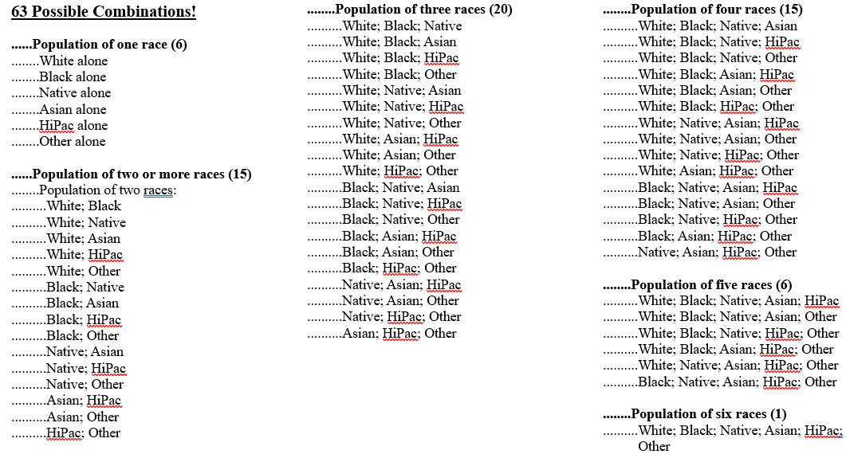
Since each combination can be Hispanic or non-Hispanic, there are 63 x 2 = 126 possibilities!

Slide 4
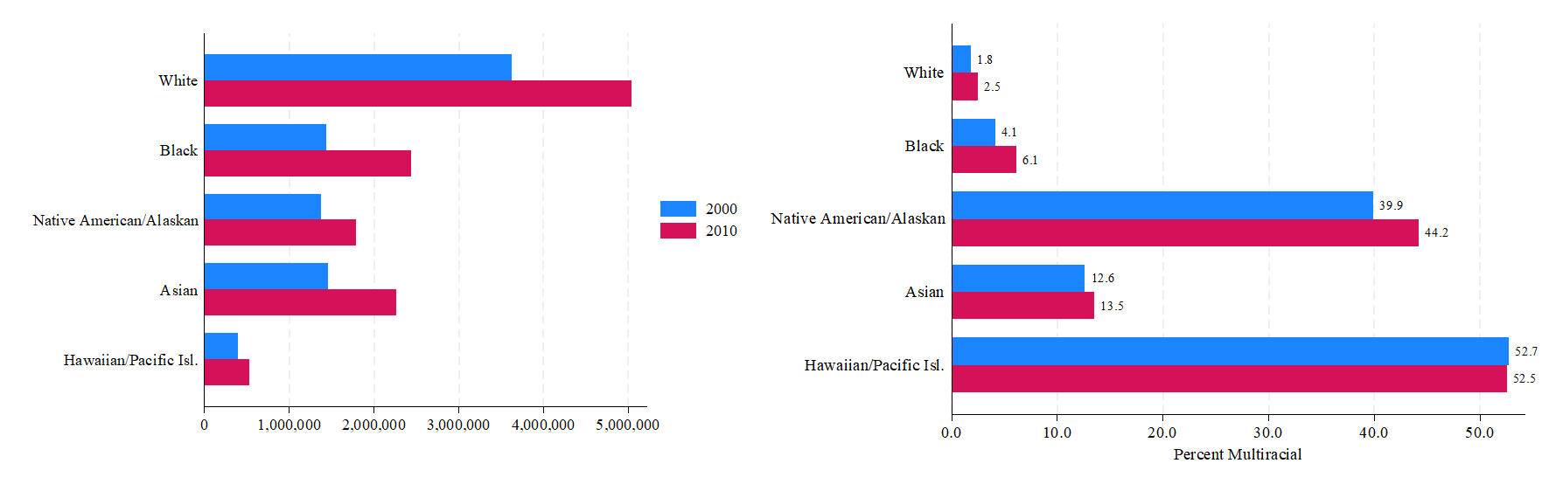
The Growing Multiracial Population
The population of these individuals grew 32 percent from 6.8 million in 2000, when the Census Bureau first allowed respondents to identify as multiracial, to 9.0 million in 2010.

Slide 5
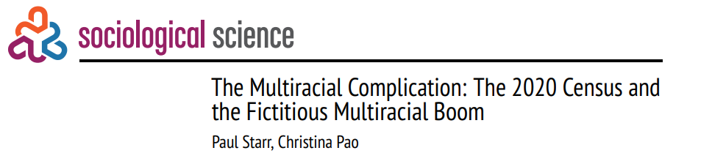
A Multiracial Boom?
An astounding 276 percent increase between 2010 and 2020, dubbed a “multiracial boom” in the media.
Rises from 2.9 to 10 percent of US population!
However, it turns out to be an illusion based on changes in the Census Bureau coding algorithms (Starr and Pao 2024).

Slide 6
Black: Metros with Highest Percent Multiracial

Slide 7
Prior Methods
A common approach is to ignore multiracial persons, contrast non-Hispanic single-race whites with non-Hispanic single-race blacks.
The Logan Rule: “Our approach for handling multiple race responses … is to treat a person as black if they described themselves as black plus any other race; as Asian if they listed Asian plus any other race except black; and as Native American/other race for any other combination” (Logan and Stults 2011: 24).
Glaeser and Vigdor (2012) follow the exact opposite approach. They identify blacks as those who are indicate black as their only race. They then compute segregation indices of blacks, so defined, from non-blacks including all whites, Hispanics, and multiracial persons, some of whom are partly black.
None of these methods reflects the reality of people who span 2 or more races.

Slide 8
How to calculate White/Black segregation?
White
(Single Race)
1
Black
(Single Race)
1
Other Races
(Single Race)
4
White + Other
(2 Races)
4
White + Black
(2 Races)
1
Black + Other
(2 Races)
4
Other + Other
(2 Races)
6
White + Others
(3+ Races)
11
White + Black + Others (3+ Races) 15
Black + Others
(3+ Races)
11
Other Races in Combination
(3+ Races) 5

Slide 9
Approach 1: Ignore multiracial persons
White
(Single Race)
Black
(Single Race)
Other Races
(Single Race)
White + Other
(2 Races)
White + Black
(2 Races)
Black + Other
(2 Races)
Other + Other
(2 Races)
White + Others
(3+ Races)
White + Black + Others
(3+ Races)
Black + Others
(3+ Races)
Other Races in Combination
(3+ Races)

Slide 10
Approach 1a: treat multiracial as a category
White
(Single Race)
Black
(Single Race)
Other Races
(Single Race)
White + Other
(2 Races)
White + Black
(2 Races)
Black + Other
(2 Races)
Other + Other
(2 Races)
White + Others
(3+ Races)
White + Black + Others
(3+ Races)
Black + Others
(3+ Races)
Other Races in Combination
(3+ Races)

Slide 11
Approach 2: Logan and Stults (2011)
White
(Single Race)
Black
(Single Race)
Other Races
(Single Race)
White + Other
(2 Races)
White + Black
(2 Races)
Black + Other
(2 Races)
Other + Other
(2 Races)
White + Others
(3+ Races)
White + Black + Others
(3+ Races)
Black + Others
(3+ Races)
Other Races in Combination
(3+ Races)

Slide 12
Approach 3: Glaeser and Vigdor (2012): “The End of Segregated Century”
White
(Single Race)
Black
(Single Race)
Other Races
(Single Race)
White + Other
(2 Races)
White + Black
(2 Races)
Black + Other
(2 Races)
Other + Other
(2 Races)
White + Others
(3+ Races)
White + Black + Others
(3+ Races)
Black + Others
(3+ Races)
Other Races in Combination
(3+ Races)

Slide 13
What we need, but how to do it?
White
(Single Race)
Black
(Single Race)
Other Races
(Single Race)
White + Other
(2 Races)
White + Black
(2 Races)
Black + Other
(2 Races)
Other + Other
(2 Races)
White + Others
(3+ Races)
White + Black + Others
(3+ Races)
Black + Others
(3+ Races)
Other Races in Combination
(3+ Races)

Slide 14
Taking account of multiple races
White
(Single Race)
Black
(Single Race)
White + Other
(2 Races)
White + Black
(2 Races)
Black + Other
(2 Races)
White + Others
(3+ Races)
White + Black + Others
(3+ Races)
Black + Others
(3+ Races)

Slide 15
Index of Dissimilarity

Slide 16
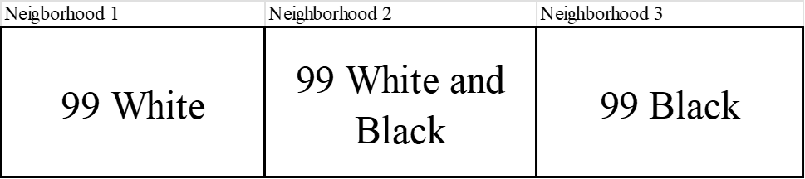
Maximum Segregation with Multiracial People
Segregation is the separation of groups over neighborhoods.
In this scenario, segregation is maximized, but D = 0.667
Nobody can be moved to increase D.
We need to normalize by the segregation of individuals.
  When everybody is in just one group, individual segregation is 1.
  But with multiracial persons, whiteness and blackness is mixed within multiracial persons.

Slide 17
Normalizing by segregation across individuals
Neighborhoods:
Individuals:
Based on ideas from Information Theory (Shannon 1948).
Jargowsky, Paul A., and Jeongdai Kim. 2009. “The Information Theory of Segregation: Uniting Segregation and Inequality in a Common Framework.” Research on Economic Inequality 17 (October):3–31.

Slide 18
MRD ranges from 0 to 1
The segregation of neighborhoods can never be greater than the segregation of individuals. Thus, the normalization ensures that MRD ranges from 0 (perfect integration) to 1 (maximum segregation).

Slide 19
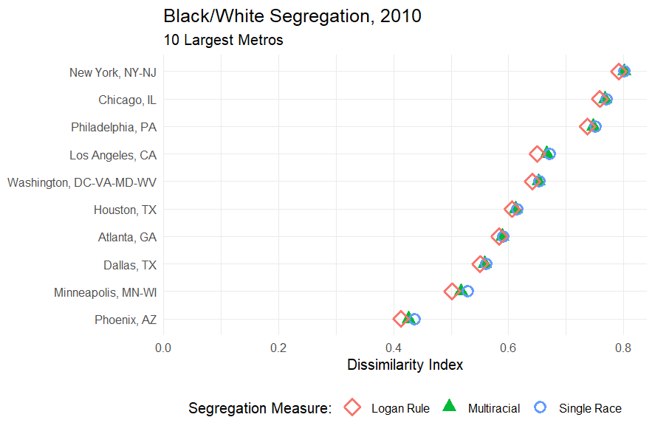

Slide 20
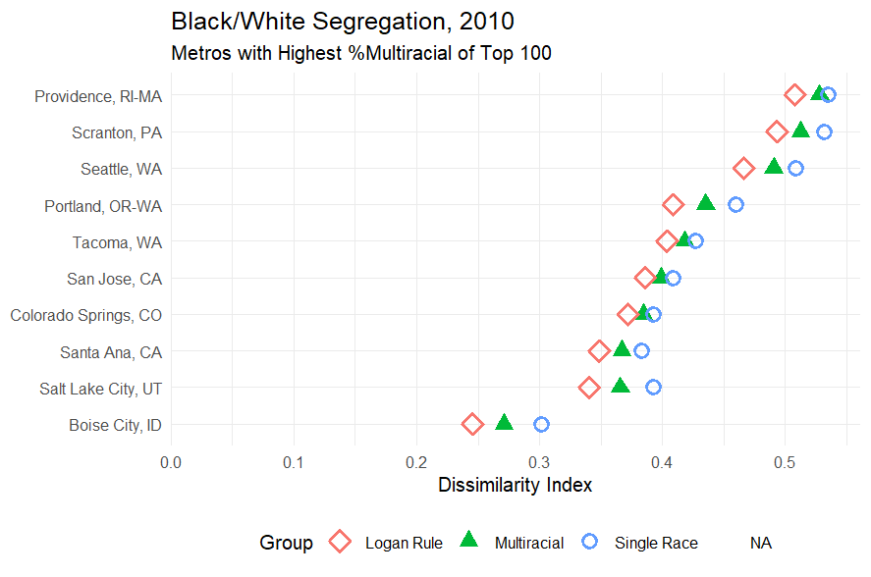

Slide 21
Change between 2000 and 2010

Slide 22
Conclusion
The Index of Dissimilarity can be applied in a theoretically justified manner to populations containing mixed-race individuals.
There are multiracial versions of other segregation measures, for example, Entropy and Gini, based on the same ideas (Jargowsky and Kim 2009).
As the multiracial population grows, this may become increasingly relevant.
Possible applications in other areas.

